Slide 1
Image Processing and Computer Vision on GPU
Frank Lamosa
De Beers Technology, De Beers UK

Slide 2
GPU: Overview and applications
Why use GPUs?
When would you not use?
What is parallelism?
Abstraction models
Hardware
Memory
Execution
Tools (Programming/program architecture)
Sample applications and demo

Slide 3
Preamble: some notes
Nomenclature: both NVIDIA CUDA and OpenCL terminology used
Code: mainly CUDA, but analogous code exists for OpenCL
The reason for CUDA code: higher level interface – OpenCL is more at driver level so have to manage various aspects of launching kernels, e.g., dispatching a kernel function (GPU-executing function)
Kernel<<<GridSize, BlockSize>>>(arg1, arg2, …, argN) →CUDA
clEnqueKernelArg(index, argType, Val) ->create argument stack
clEnqueuKernelArt(index + 1, argType, val) ->next element in stack
clEnqueueKernel() to dispatch kernel

Slide 4
Why use GPUs?
Same operation on multiple data (SIMD)
=>massively parallel operations
Computation intensive – data transfer latencies are high; need computation to exceed data transfer times
Access large blocks of data in contiguous addresses
Have thousands (tens of thousands) of threads in parallel

Slide 5
When not to use GPUs?
Specific memory access patterns not suitable:
data scattered in memory so read/write is serialised
operations are non-local (data has a degree of sparseness or not sequential)
write operations: limited number of output addresses =>possible write contention
because synchronisation of parallel threads of execution has limitations, operations on global data set must have degree of independence
In other words, do not have dependence on read/write operations between threads that are executing on different parts of data set

Slide 6
What is parallelism?
How do you define parallelism?
What kinds of parallelism are there?
Functional, data
What kind of parallelism do we use in GPUs?
Data parallelism

Slide 7
GPU Abstraction
Abstraction on several levels:
Hardware
Memory
Execution

Slide 8
Hardware model
Abstraction of GPU architecture showing components of PC system: host memory, DMA controller, GPU (with subcomponents – global memory, instruction buffer, kernel dispatcher, cores)

Slide 9
Hardware model
Core/compute unit:
Collection of SIMD processors (see next slide)
Shared resources (local memory: shared memory, cache, and local register files)
Many compute units in GPU – can operate independently (possible functional parallelism)

Slide 10
Tools: hardware model of core
cache
Shared Memory
SIMD 1
SIMD 2
SIMD 3
SIMD 4
Inst. Buffer 0
Inst. Buffer 1
Inst. Buffer 2
Inst. Buffer 3
Inst. Buffer 4
Inst. Buffer 5
Inst. Buffer 6
Inst. Buffer 7
Inst. Buffer 8
Inst. Buffer 9
Inst. Buffer 0
Inst. Buffer 1
Inst. Buffer 2
Inst. Buffer 3
Inst. Buffer 4
Inst. Buffer 5
Inst. Buffer 6
Inst. Buffer 7
Inst. Buffer 8
Inst. Buffer 9
Inst. Buffer 0
Inst. Buffer 1
Inst. Buffer 2
Inst. Buffer 3
Inst. Buffer 4
Inst. Buffer 5
Inst. Buffer 6
Inst. Buffer 7
Inst. Buffer 8
Inst. Buffer 9
Inst. Buffer 0
Inst. Buffer 1
Inst. Buffer 2
Inst. Buffer 3
Inst. Buffer 4
Inst. Buffer 5
Inst. Buffer 6
Inst. Buffer 7
Inst. Buffer 8
Inst. Buffer 9

Slide 11
Memory model
Memory has different levels, depending on distance from processing elements
Closer to processing elements = faster memory access
BUT
Real-estate is expensive, so limited availability of memory as we get closer to processing elements.
Next slide: Compute units/Cores and various memory levels (shared – on-core); constant, texture global to all cores

Slide 12
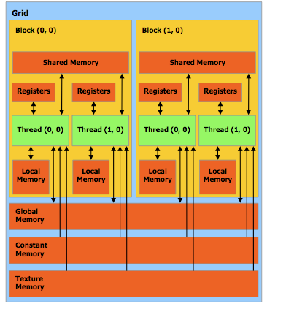
Execution models
More detailed sketch of GPU cores/memory

Slide 13
Execution models (cont’d)
In this view, a number of refinements:
Two other types of memory: constant (read-only but very fast – also small), texture memory – hardware for specific transformations (rotation, scaling, interpolation)
Global access but with tradeoffs-read only OR limited operations (for speed)

Slide 14
Execution model
Can see shared memory for each core
All threads in core, access shared memory – but NOT shared between cores
How are threads mapped to cores?
Programming model

Slide 15
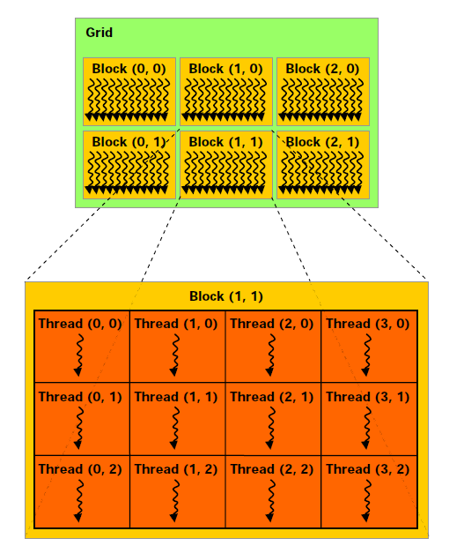
Tools: Programming model
Larger scale representation of cores and threads
Each core runs set of threads independently of other cores (no synch as each core has its own scheduler)

Slide 16
Tools: Programming model
Basic functional unit of work/execution: THREAD
Threads are independent
Threads are grouped together in structures due to hardware architecture – thread block/work group
Thread blocks/work groups are executed on the same core (compute unit)
Can use shared memory; partition register file so each thread has its local (in-thread) memory
However, scheduling is not necessarily simultaneous
Basic scheduling unit is 32-thread groups called warps (wavefronts, in OpenCL)

Slide 17
Tools: Programming model
Dispatch:
Dispatch is in groups of 32 threads
Groups of threads (warps/wavefronts) can be dispatched simultaneously or sequentially
Multiple warps/wavefronts per block (remember, block/workgroup is mapped onto core – but not simultaneous necessarily)
Synchronisation: because threads on a core (compute unit) share resources, they can be synchronized – barriers are possible.
However, because different cores/compute units have different schedulers, there is no explicit synchronization
In addition: instruction synch, but no memory access synch in shared memory (see figure)

Slide 18
Tools: Programming model
Synchronisation between read/write for instruction issue
However, for write sequence, no automatic synch
Thread block

Slide 19
Tools: Programming model
Anatomy of a GPU program
Allocate memory on hardware
Move data into GPU memory
Dispatch the kernel (why dispatch?)
Host call invokes GPU scheduler which loads instructions into instruction buffer on cores
Synchronise event (if needed)
Retrieve data from memory
Release resources

Slide 20
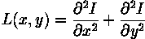
Examples: Image filtering
Laplacian of Gaussian
Laplacian operator:
Computes 2nd derivative – finds inflection points and edge is at zero (between inflection points)

Slide 21
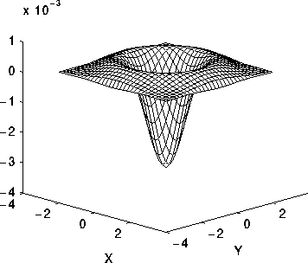
Examples: Image filtering
Gaussian filter is first applied, for smoothing
Resulting filter is:

Slide 22
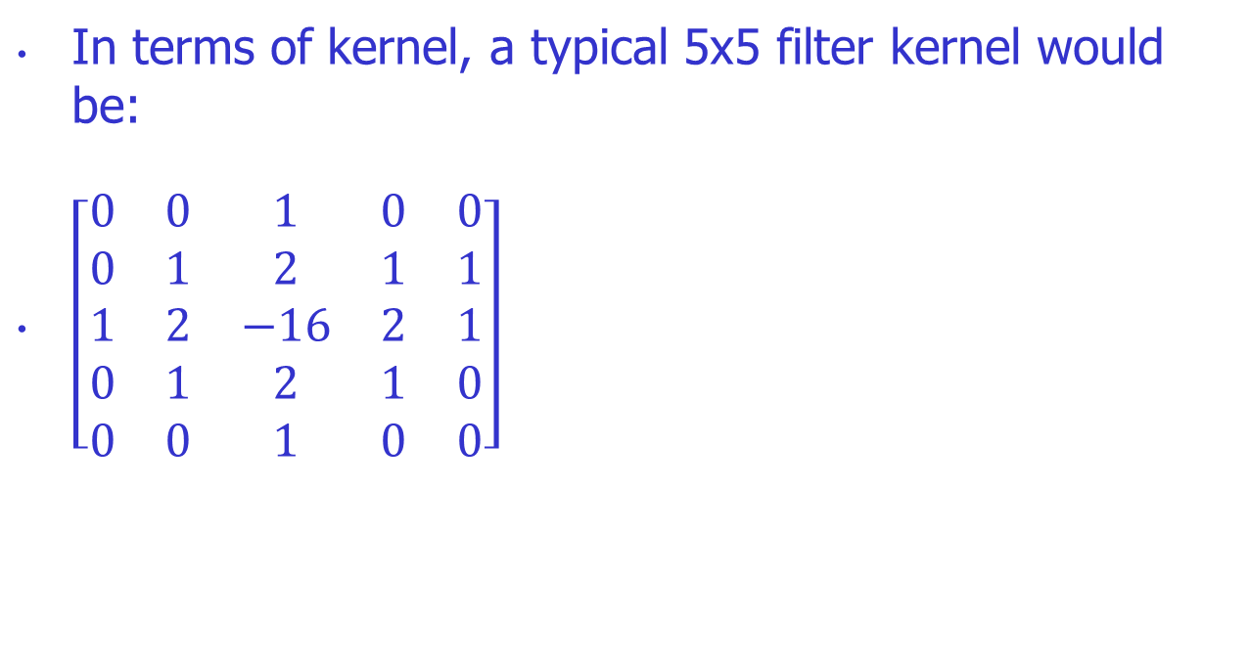
Examples: Image filtering
In terms of kernel, a typical 5x5 filter kernel would be:
$\left[\begin{matrix}0 & 0 & 1 & 0 & 0 \\ 0 & 1 & 2 & 1 & 1 \\ 1 & 2 & −16 & 2 & 1 \\ 0 & 1 & 2 & 1 & 0 \\ 0 & 0 & 1 & 0 & 0\end{matrix}\right]$

Slide 23
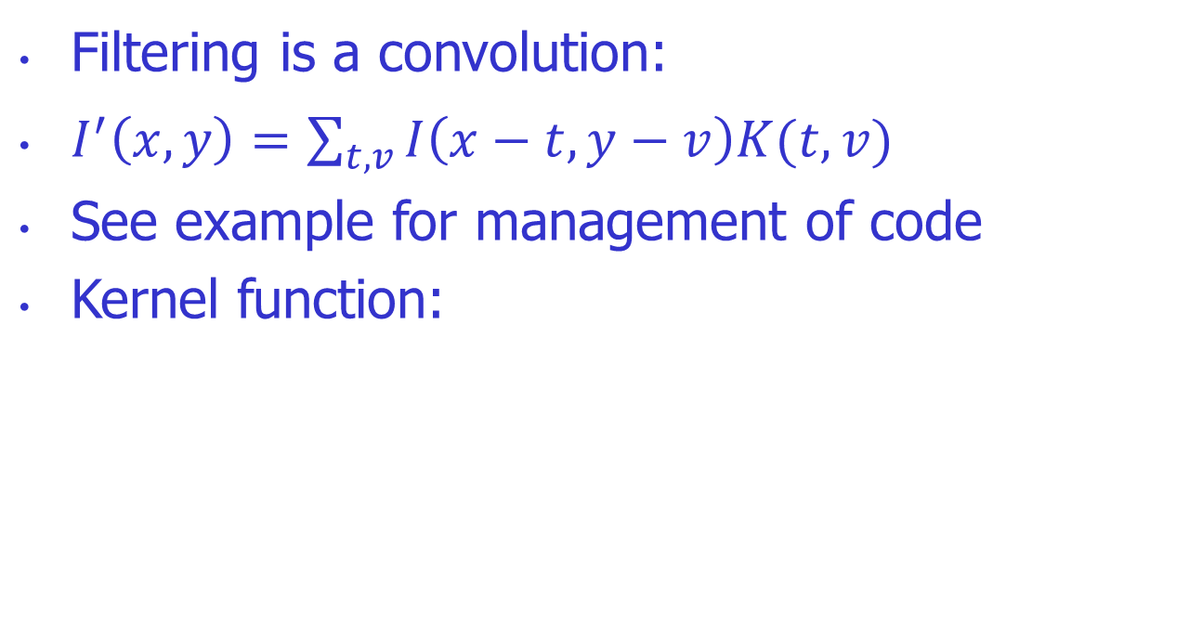
Examples: Image filtering
Filtering is a convolution:
$I^{′}\left(x,y\right)=\sum_{t,v}{I\left(x−t,y−v\right)K(t,v)}$
See example for management of code
Kernel function:

Slide 24
Examples: Image filtering
__global__
void g_filterImage_5x5(float* imageIn, float* kernel, float* imageOut, float scaleFactor, int imW, int imH)
{
// ------------- intrinsic parameters -------------------------------------------------- blockDim, threIdx
unsigned int c = blockDim.x*blockIdx.x + threadIdx.x;
unsigned int r = blockDim.y*blockIdx.y + threadIdx.y;
unsigned int bufferIndex = r * imW + c;
//check that the thread is within the region of the image //NOT GOOD PRACTICE: Demo Only
if (c >= imW || r >= imH) { return; }
//Compute the convolution and write to the shared output buffer
if ((c < (CONVOLUTION_KERNEL_SIZE_5 / 2)) || (c > (imW - CONVOLUTION_KERNEL_SIZE_5 / 2)) || //Boundaries of convolution
(r < (CONVOLUTION_KERNEL_SIZE_5 / 2)) ||(r > (imH - CONVOLUTION_KERNEL_SIZE_5 / 2)))
{ imageOut[bufferIndex] = imageIn[bufferIndex];}
else{
float cumulativeSum = 0.0;
for (int kY = 0; kY < CONVOLUTION_KERNEL_SIZE_5; kY++)
{ for (int kX = 0; kX < CONVOLUTION_KERNEL_SIZE_5; kX++)
{ cumulativeSum += imageIn[(r + kY - 2)*imW + c + kX - 2] * kernel[kY*CONVOLUTION_KERNEL_SIZE_5 + kX]; }
}
imageOut[r*imW + c] = cumulativeSum*scaleFactor;
}
//synch all the threads before the shared memory is transferred to global memory
__syncthreads();
return;
}

Slide 25
Examples: Image filtering
Note: syncthreads() not really needed
However, for shared memory, may be needed
Want to ensure all writes are completed before next reads (to ensure that the shared memory is coherent)
Why is image filtering well designed for GPU?
Largely, point operation
There is read of adjacent addresses, but only read, no read, so content is not modified and memory consistency not at risk

Slide 26
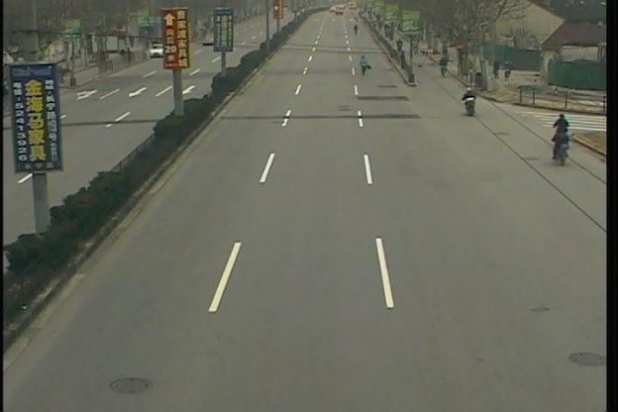

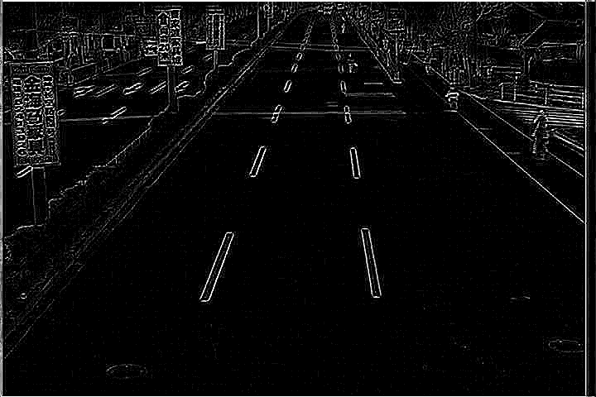
Examples: Image filtering
Input image with processed image (and contrast adjusted – showing need for normalization factor in convolution)
Demo program illustrates anatomy of GPU program. See github link.

Slide 27
Examples: Noise reduction
Wiener Filter
Filter constructed for noise reduction
Designed to minimize error between signal estimated by the filter and ideal signal
Although normally implemented in the time domain, it can be done in the frequency
The advantage is that it can then be done as a product of frequency components, point operations

Slide 28
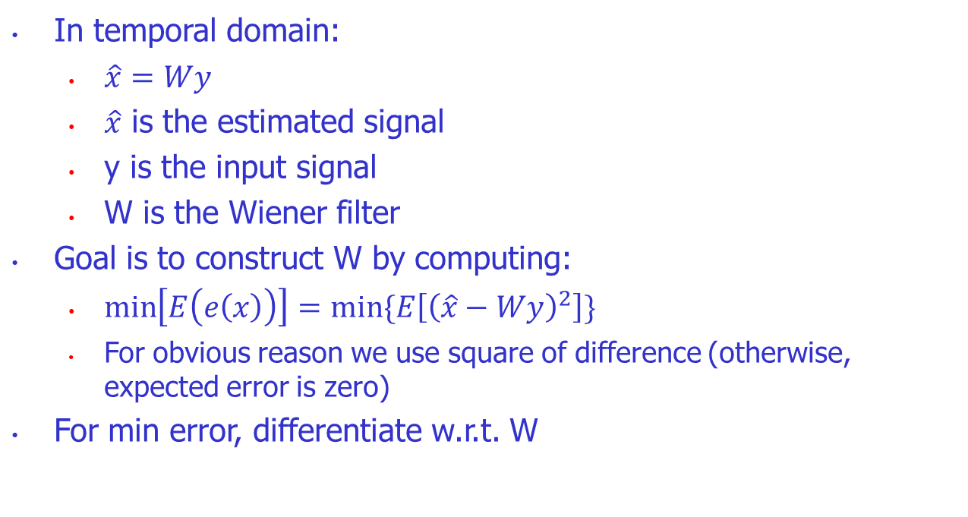
Examples: Noise reduction
In temporal domain:
$\hat{x}=Wy$
$\hat{x}$ is the estimated signal
y is the input signal
W is the Wiener filter
Goal is to construct W by computing:
$\min\left[E\left(e\left(x\right)\right)\right]=min⁡\{E\left[{\left(\hat{x}−Wy\right)}^{2}\right]\}$
For obvious reason we use square of difference (otherwise, expected error is zero)
For min error, differentiate w.r.t. W

Slide 29
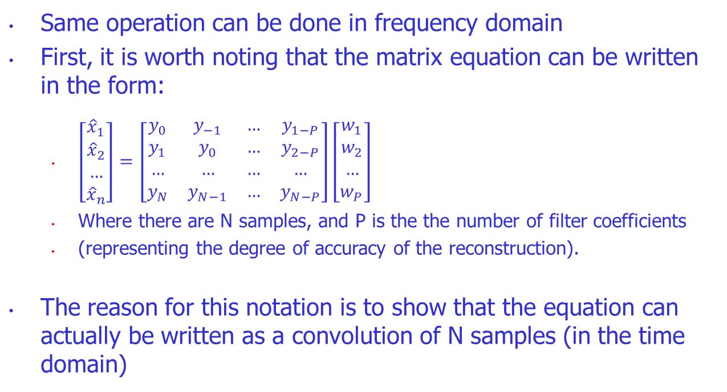
Examples: Noise reduction
Same operation can be done in frequency domain
First, it is worth noting that the matrix equation can be written in the form:
$\left[\begin{matrix}{\hat{x}}_{1} \\ {\hat{x}}_{2} \\ … \\ {\hat{x}}_{n}\end{matrix}\right]=\left[\begin{matrix}y_{0} & y_{−1} & … & y_{1−P} \\ y_{1} & y_{0} & … & y_{2−P} \\ … & … & … & … \\ y_{N} & y_{N−1} & … & y_{N−P}\end{matrix}\right]\left[\begin{matrix}w_{1} \\ w_{2} \\ … \\ w_{P}\end{matrix}\right]$
Where there are N samples, and P is the the number of filter coefficients
(representing the degree of accuracy of the reconstruction).
The reason for this notation is to show that the equation can actually be written as a convolution of N samples (in the time domain)

Slide 30
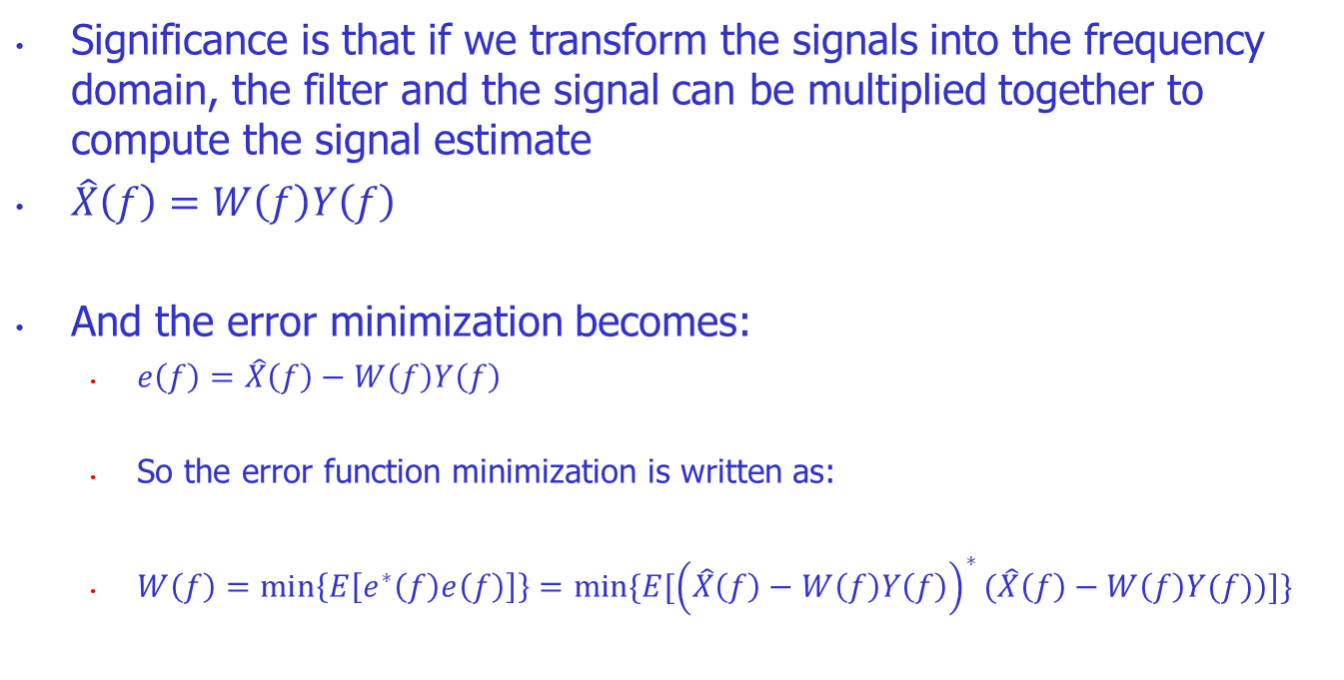
Examples: Noise reduction
Significance is that if we transform the signals into the frequency domain, the filter and the signal can be multiplied together to compute the signal estimate
$\hat{X}\left(f\right)=W\left(f\right)Y\left(f\right)$
And the error minimization becomes:
$e\left(f\right)=\hat{X}\left(f\right)−W\left(f\right)Y\left(f\right)$
So the error function minimization is written as:
$W\left(f\right)=\min\left\{E\left[e^{∗}\left(f\right)e\left(f\right)\right]\right\}=min⁡\{E[{\left(\hat{X}\left(f\right)−W\left(f\right)Y\left(f\right)\right)}^{∗}(\hat{X}\left(f\right)−W\left(f\right)Y(f))]\}$

Slide 31
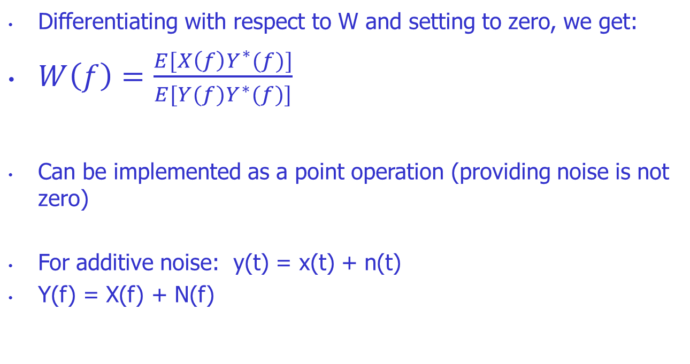
Examples: Noise reduction
Differentiating with respect to W and setting to zero, we get:
$W\left(f\right)=\frac{E[X\left(f\right)Y^{∗}(f)]}{E[Y(f)Y^{∗}(f)]}$
Can be implemented as a point operation (providing noise is not zero)
For additive noise: y(t) = x(t) + n(t)
Y(f) = X(f) + N(f)

Slide 32
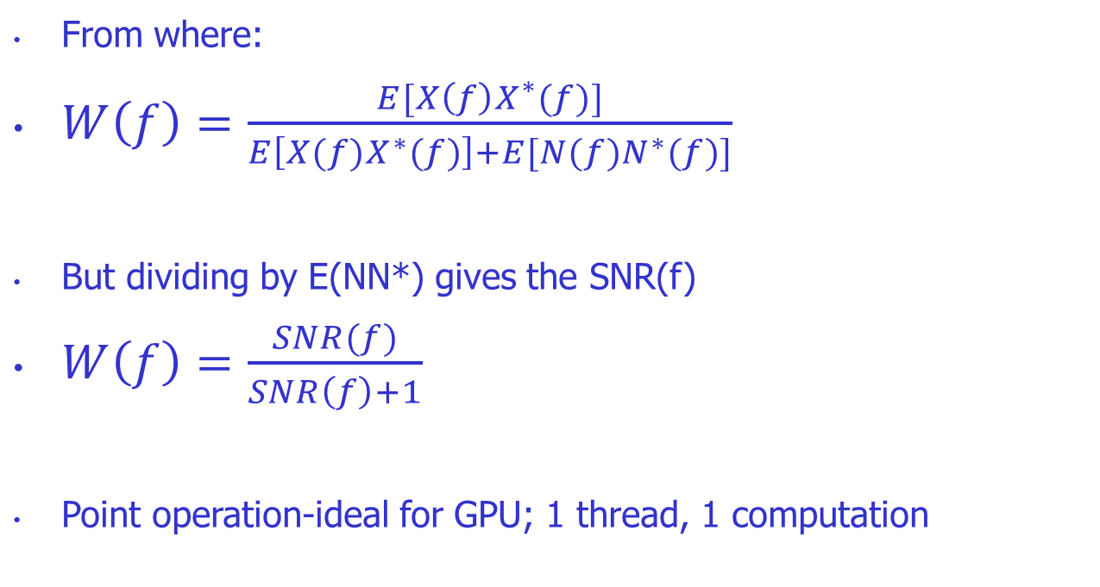
Examples: Noise reduction
From where:
$W\left(f\right)=\frac{E[X\left(f\right)X^{∗}(f)]}{E\left[X(f)X^{∗}(f)\right]+E[N(f)N^{∗}(f)]}$
But dividing by E(NN*) gives the SNR(f)
$W\left(f\right)=\frac{SNR(f)}{SNR\left(f\right)+1}$
Point operation-ideal for GPU; 1 thread, 1 computation

Slide 33
Examples: Noise reduction
FFT libraries (both by AMD and NVIDIA)
NVIDIA: CUFFT
cuFFTExecC2C()
cuFFTExecC2R()
Can then simply multiply spectra.

Slide 34
Additional examples
Pyramids:
Using texture elements for subsampling/interpolation on hardware
Laplacian pyramid – smoothing and downsampling
Upsampling and interpolation
Band pass signals
Different weights => Can alter contrast (unsharp masking)

Slide 35
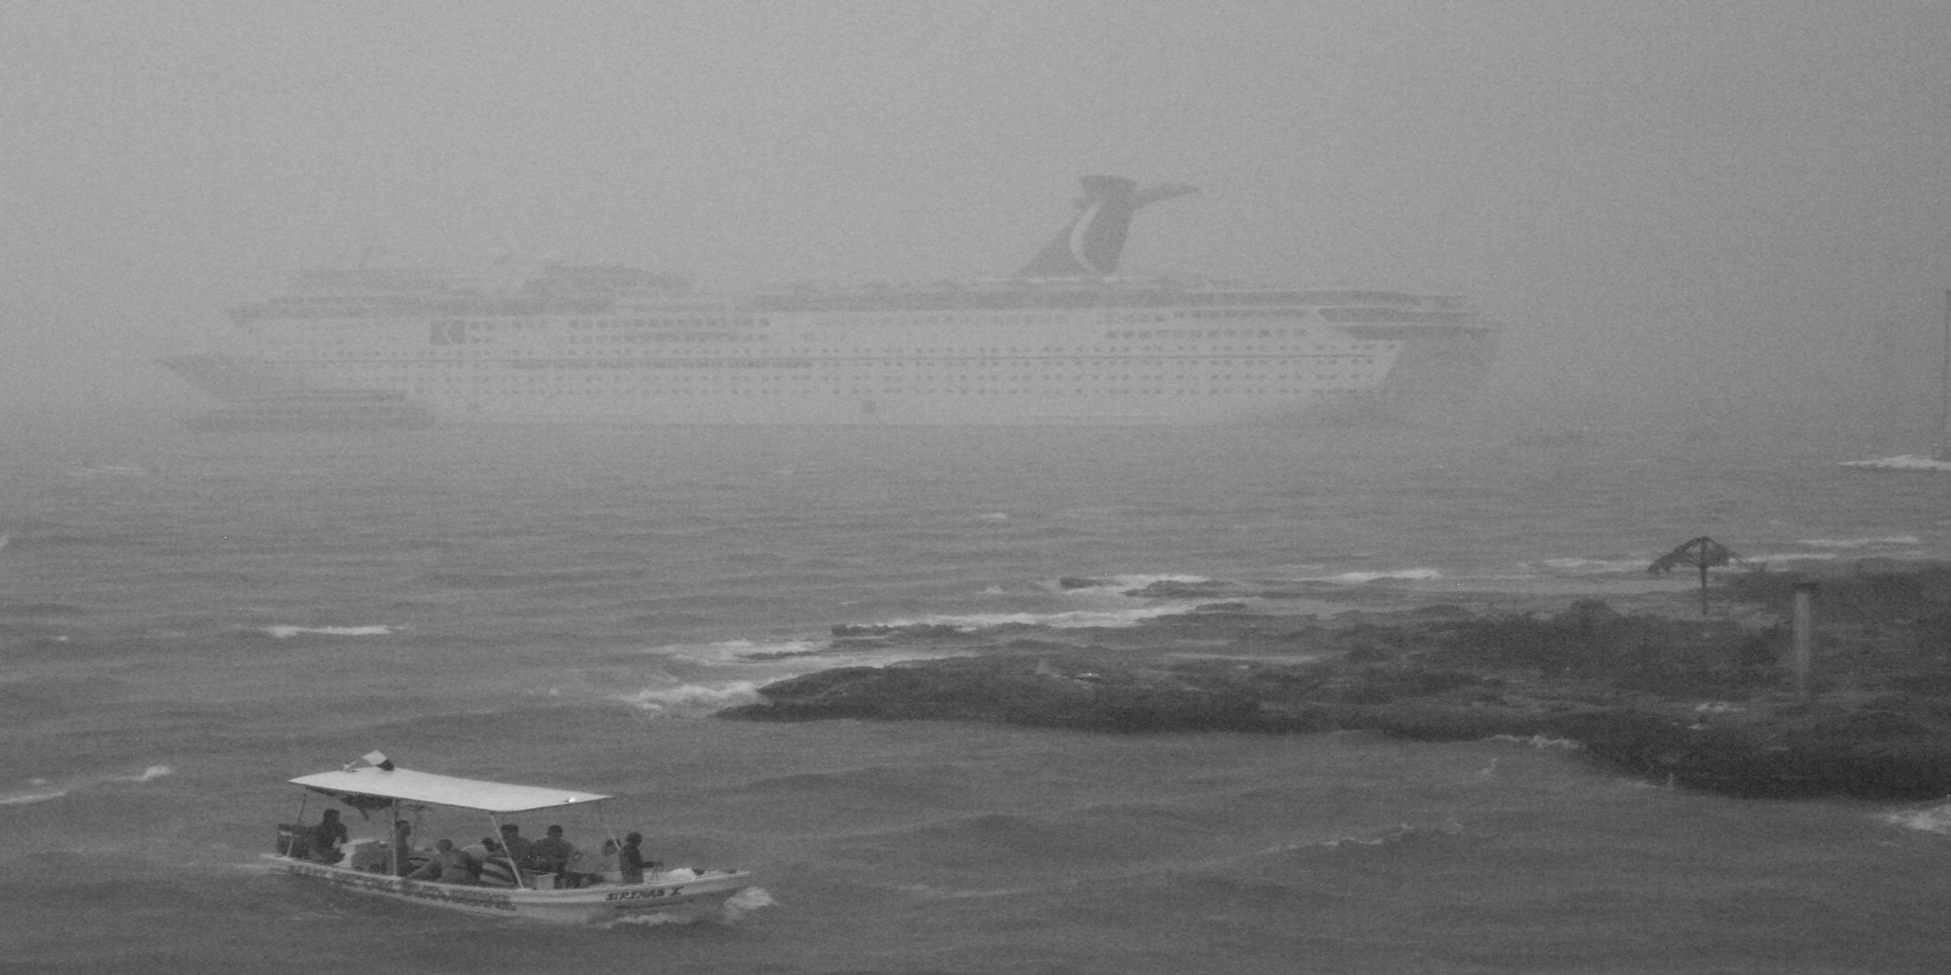

Additional examples
g_{N-1}
G_{N-1}
...
...
g₁
G₀
g₀

Slide 36
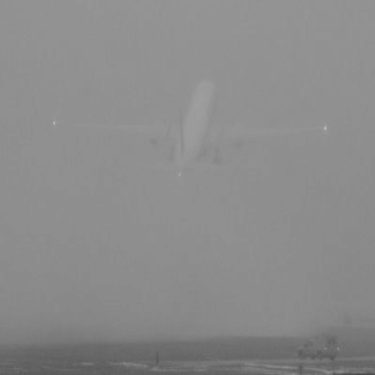
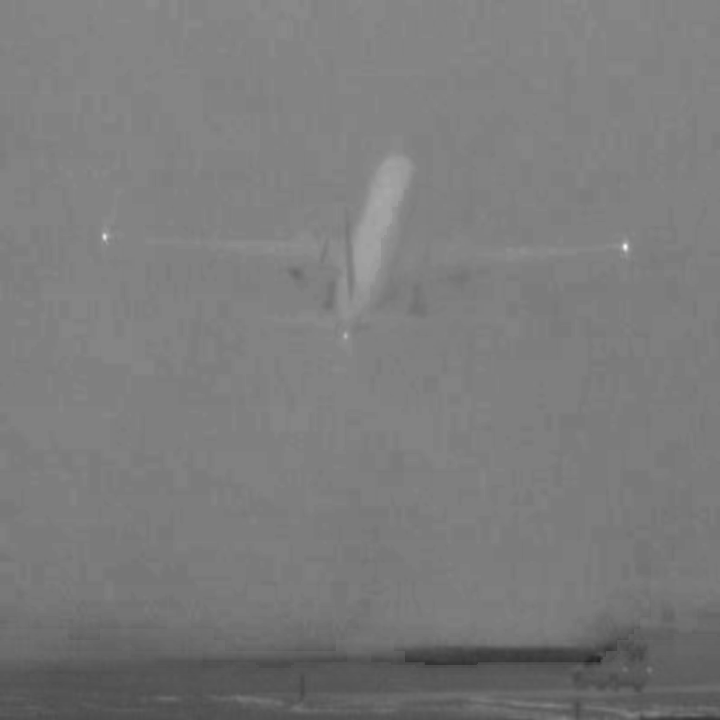
Additional examples
Aircraft in fog

Slide 37
Concluding remarks
Just a flavour of GPU programming
Focusing on concepts
Sample code (partly done)
Have basic working example
But adding some timing information for the various memory models
Also, modifying example to used share memory
Code in place not tested
Will make available in the next 2 weeks (if interested)
Much more to learn – but cannot really go into it in one hour
But, if interested, can provide tutorial with code

